Slide 1
Dockerizing Java: From Monolith to Container
Modernizing Java Applications
By Ananth Kumar Ganesna ( 100800 )

Slide 2
1
Why Docker for Java?
2
Java Monolith: Typical Architecture
3
Why containerize?
Agenda
4
Docker Basics
5
Step-by-Step: Dockerizing a Java App
6
Live Demo / Walkthrough
7
Q&A

Slide 3
Why Docker for Java?
Problems with traditional Java deployments:
Works on my machine
Complex configs
Environment mismatches
Pluggable components

Slide 4
Why Docker for Java?
✔
✔
✔
✔
✔
✔
✔
✔
✔
✔
✔
java.lang.UnsupportedClassVersionError
java.lang.ClassNotFoundException
java.lang.NoClassDefFoundError
java.lang.UnsatisfiedLinkError
javax.naming.ConfigurationException
java.io.FileNotFoundException
java.net.BindException
java.net.SocketTimeoutException
java.net.UnknownHostException
java.sql.SQLException
java.lang.IllegalStateException
→ JDK mismatch
→ Missing classpath JAR
→ Lazy load fail
→ Missing native lib
→ Missing config
→ Missing file/resource
→ Port conflict
→ Network timeout
→ DNS/hostname issue
→ DB driver/config issue
→ Bad config/env var

Slide 5
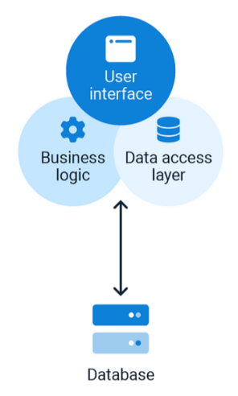
Java Monolith: Typical Architecture
A monolithic architecture is a software design pattern where the entire application is built as a single, unified unit. All components—such as the user interface, business logic, and data access layer—are tightly coupled and operate within a single codebase.
Advantages
Simplicity: Easier to develop, test, and deploy, making it ideal for small to medium-sized applications.
Unified Management: Centralized monitoring, logging, and configuration reduce operational overhead.
Performance Efficiency: Since all components reside within a single process, inter-component communication is faster compared to microservices.
Disadvantages
Scalability Challenges: Scaling individual components separately is not possible; the entire application must be scaled, leading to resource inefficiency.
Tight Coupling: Any modification in one part of the application often requires redeploying the entire system.
Maintenance Complexity: Over time, the codebase grows, making it harder to maintain and refactor.

Slide 6
Why containerize?
A big single JAR/WAR monolith gains huge value when you wrap it in a Docker container
Predictable Builds
You build the image once → same app, same JDK, same OS layer → no more “it works on my machine.”
Easy rollbacks
If a deploy breaks, roll back to the previous image tag in seconds. No messing with servers or configs.
Consistent across dev/stage/prod
Same image runs everywhere → no OS version, JDK, native lib, or config drift.
Better scaling (even for monoliths)
You can run multiple replicas behind a load balancer → scale out horizontally without changing the app.
Simpler CI/CD pipelines
Docker image becomes the artifact → CI server builds, tags, and ships it → deploy is just docker run.

Slide 7
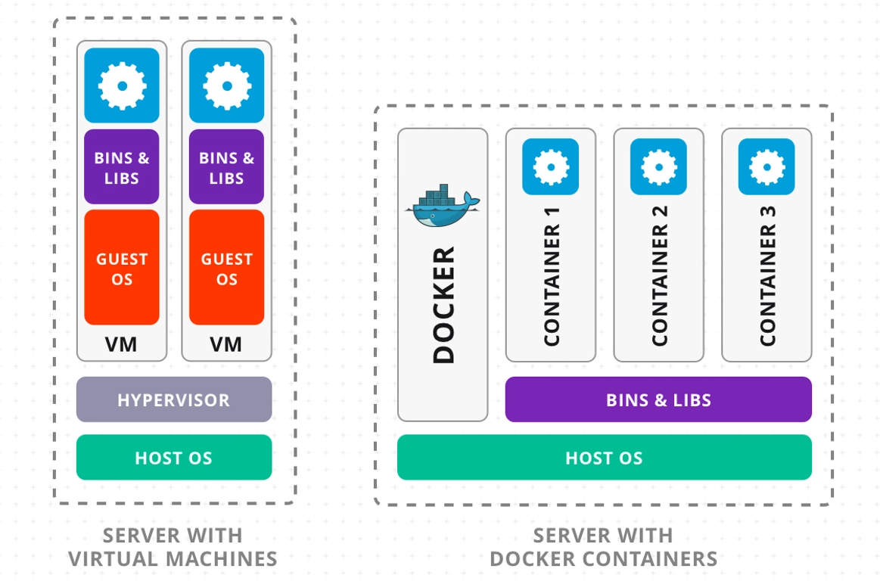
Why containerize?

Slide 8
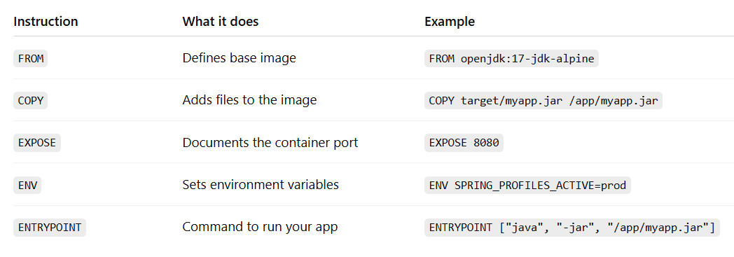
Docker Basics
Docker is a platform for building, shipping, and running applications in lightweight containers. It lets you package your code + runtime + configs into one portable unit that runs the same everywhere.
A Dockerfile is like a recipe or blueprint for building a Docker image. It tells Docker exactly how to build a container image for our app — step by step.

Slide 9
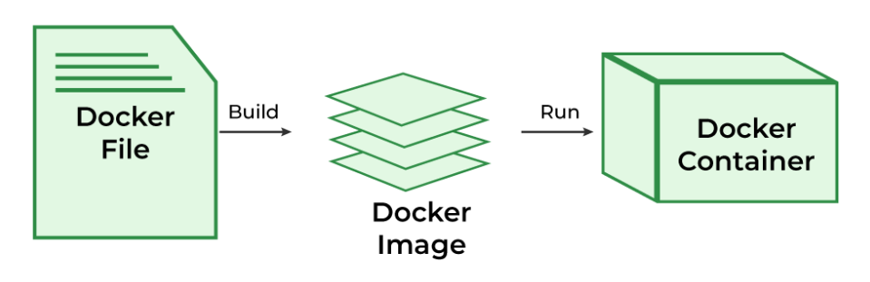
Docker Basics

Slide 10
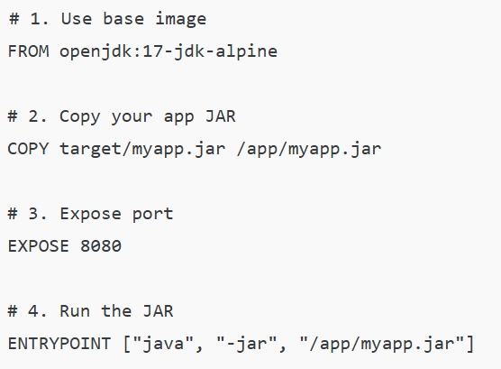
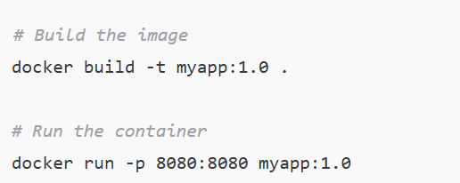
Docker Basics
A Dockerfile is a plain-text recipe that defines how to build your image.
Build Instructions

Slide 11
Docker Basics
Docker image
What is openjdk:17-jdk-alpine? :- It’s an official base image provided on Docker Hub.
openjdk → means it’s the Open Java Development Kit (JDK).
17 → means it’s Java version 17.
Jdk → includes the Java Compiler (JDK) so you can compile code.
alpine → means it’s based on Alpine Linux, which is:
Very lightweight (tiny image size).
Popular for minimal containers.
Good for faster builds, smaller deployments.

Slide 12
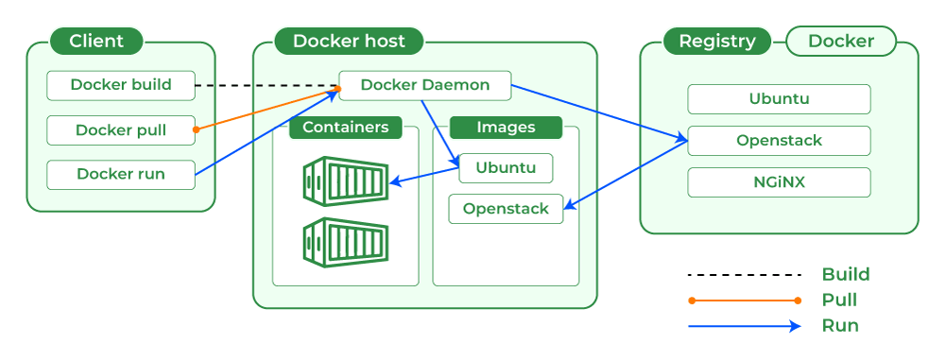
Docker Basics
A Docker container is a lightweight, portable, and isolated runtime environment that runs an application along with all its dependencies, using an image

Slide 13
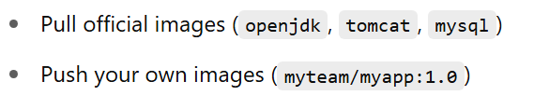
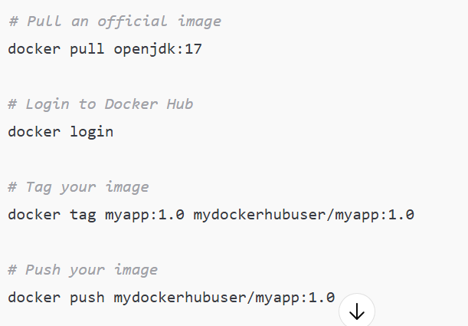
Docker Basics
Docker Hub is a public registry to share & pull Docker images.

Slide 14
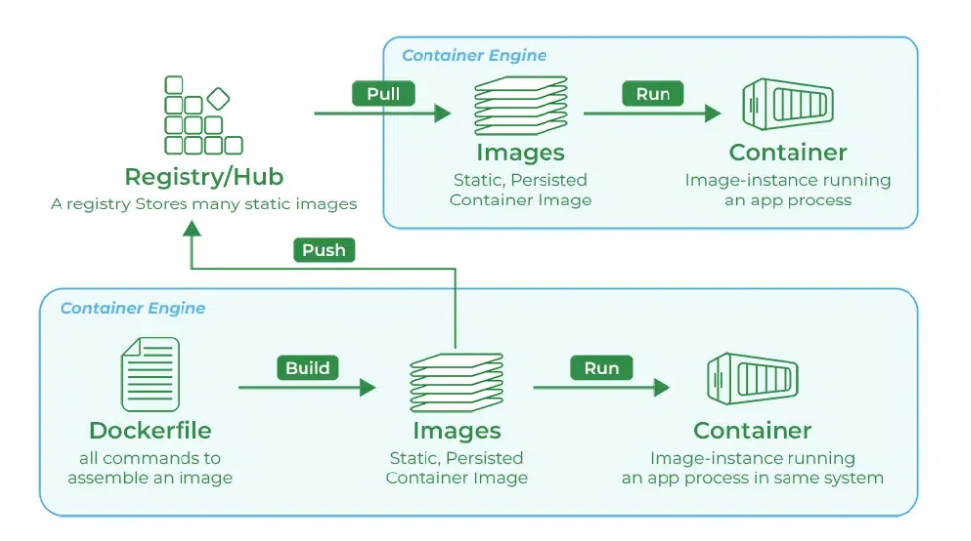
Docker Basics

Slide 15
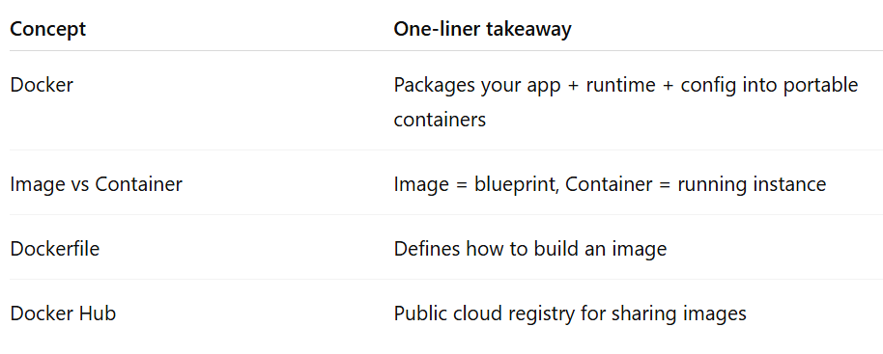
Docker Basics
Summary

Slide 16
Step-by-Step: Dockerizing a Java App
Current Setup (Without Docker)
Spring Boot App: Runs on Embedded server
Apache HTTP Server:
Acts as a reverse proxy.
Accepts incoming client requests (port 80/443).
Forwards them to your Spring Boot app (port 8080).

Slide 17
Step-by-Step: Dockerizing a Java App
Apache → Traffic Routing, SSL, Load Balancing
Docker → Packaging, Consistency, Portability, Isolation

Slide 18
Key Takeaways
“If your app runs with embedded Tomcat, then Docker doesn’t need to have Tomcat separately. If you use WARs, then yes — your Docker image must provide the servlet container.”
“Even legacy Java monoliths can be containerized: Single WAR/JAR → Docker image → same runtime everywhere. Faster testing, simpler CI/CD, no ‘works on my machine’ issues.”
“Scaling your app means adding more instances to handle more load — traditionally by adding servers, but with Docker you just run more containers on the same server, faster and cheaper.”
“Use the JDK for building. Use only the JRE for running. Smaller image, faster deploy, more secure!”
“Docker = same environment everywhere → fewer environment-related exceptions.”
In a traditional Struts or Spring MVC project, we build a single myapp.war that includes all modules — user management, payments, reports — bundled into one big deployable. If one-part changes, we repackage and redeploy the entire WAR
“A hypervisor is software that creates and manages virtual machines by abstracting physical hardware.”
“By packaging the app, its runtime, native dependencies, and config inside a Docker image, we reduce version mismatches and environment drift. This means fewer environment-related runtime exceptions.”
Future: Beyond Monolith
Once containerized, you can:
Break into microservices gradually
Use orchestration (Kubernetes)
Use CI/CD pipelines for automated deploys
“A Dockerfile ensures that everyone on the team builds the same image, with the same JDK, same OS, same app code, and same config — no manual setup, no surprises.”
“A Dockerfile means we automate the setup of our runtime environment — so no more ‘but it works on my laptop!’ excuses.”

Slide 19
Key Concept Recap
Images
Containers
Blueprints for containers.
Read-only snapshot of your app + OS + runtime.
Example: openjdk:17, myapp:1.0
Running instances of images.
Lightweight, isolated processes.
Same image = same behavior, anywhere.
Dockerfile
Docker Hub
Recipe for building images.
Defines base image, app code, runtime, configs.
Example: FROM openjdk:17, COPY, ENTRYPOINT.
Public registry for sharing images.
Pull official base images (e.g., mysql, nginx).
Push your own (docker push myapp:1.0).
Docker Compose
Tool to run multi-container apps.
Defines services, networks, volumes in docker-compose.yml.
Example: Spring Boot app + DB + reverse proxy, spun up with docker-compose up.

Slide 20
Q & A

